Slide 1
Information Retrieval Project
Creation of different retrieval models for data science documents
Marco Di Capua 878295

Slide 2
Domain description
The need for information retrieval (IR) has risen due to the continuous increase of documents available on the web. Users need to retrieve these documents based on their needs, usually expressed through a query.
The main features that a search engine should have are:
Relevance
Speed
Precision

Slide 3
Project objectives
Pre-process the title and text of documents
Create different information retrieval models
Evaluate the performance of each model and compare them

Slide 4
Dataset
The dataset that will be used for this project contains documents related to the field of computer science. The dataset contains a total of 480,968 documents and 55,277 queries.
The main information for each document that will be used in this project are:
id: unique numeric identifier of the document
title: title of the document
text: an abstract of the document

Slide 5
Dataset
The main information for each query that will be used in this project are:
qid: unique numeric identifier of the query
query: string that represent the text of the query itself
Due to the size of the collection, two different version of the document dataset will be used for the next experiment: a complete version of the original collection and a resized version of the collection that only uses 100,000 documents

Slide 6
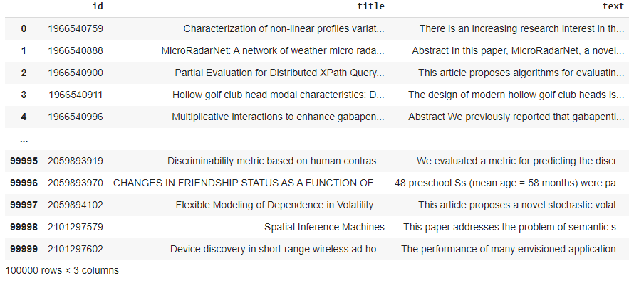
Dataset analysis
The documents dataframe that will be used looks as follows:
Taking a closer look to the content of the ‘title’ and ‘text’ columns, it's easy to say that some preprocessing is needed.

Slide 7
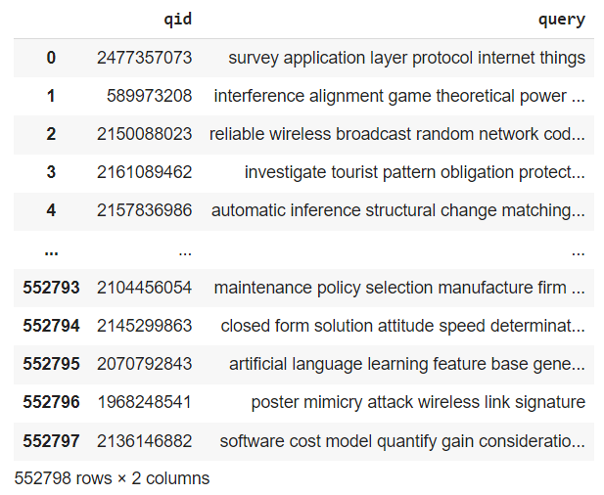
Dataset analysis
Queries dataset seems to be more adequate.
Anyways it will be preprocessed in order to reduce the amount of words into each query and obtain faster performances on the IR model.

Slide 8
Preprocessing
The first steps of preprocessing that were applied to both titles and texts of the documents and also to the query text were:
Removal of contracted forms
Setting all the text to lowercase
Removal of punctuations marks
Removal of web page links
Removal of symbols and other characters that differ from a lowercase letter

Slide 9
Preprocessing – tokenization
Tokenization of both title and text brings up some more information:
The average number of tokens per document title is: 10.43528
The average number of tokens per document text is: 146.1561
The average number of tokens per query text is: 7.92927
Within the next steps this number will be lowered

Slide 10
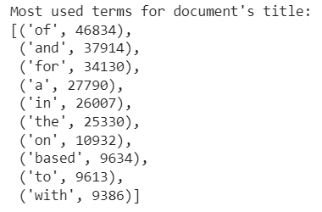
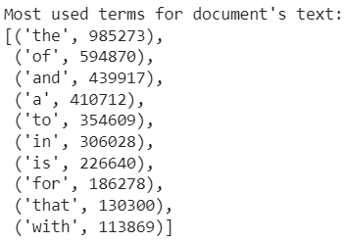
Preprocessing – stopwords
A representation of the most used terms denotes the need of further pre-processing.
In order to remove words that aren’t useful for the IR model a step of stopwords removal will do the job.

Slide 11
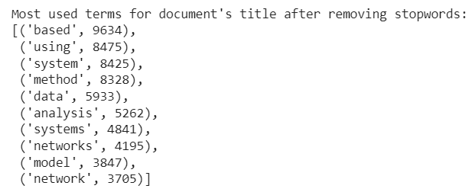
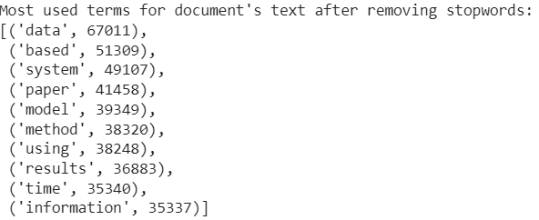
Preprocessing - stopwords
Removing stopwords increased the quality of the most used terms and removed a lot of unnecessary words.

Slide 12
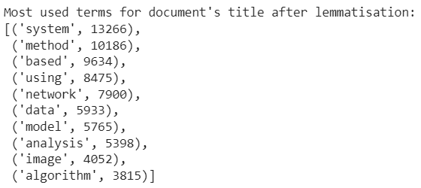
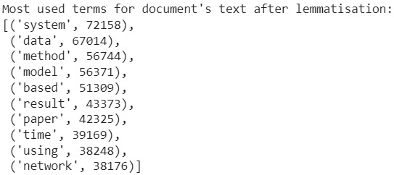
Preprocessing - lemmatization
Most used terms still contain some words with the same meaning but different plurals, such as “system” and “systems”. To bring back this words into a single a lemmatization step is needed.

Slide 13
Preprocessing - results
After all the steps of pre-processing the average number of tokens has also been changed as follows:
The average number of tokens per document title is: 7.80516
The average number of tokens per document text is: 89.50897
The average number of tokens per query text is: 7.927476

Slide 14
Preprocessing - results
To conclude the preprocessing phase, some WordCloud graphics were produced to show the difference between unprocessed text and pre-processed text.

Slide 15
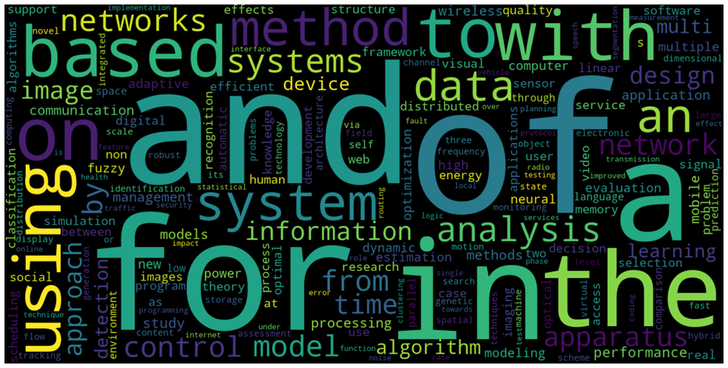
Preprocessing - results
WordCloud of unprocessed documents title:

Slide 16
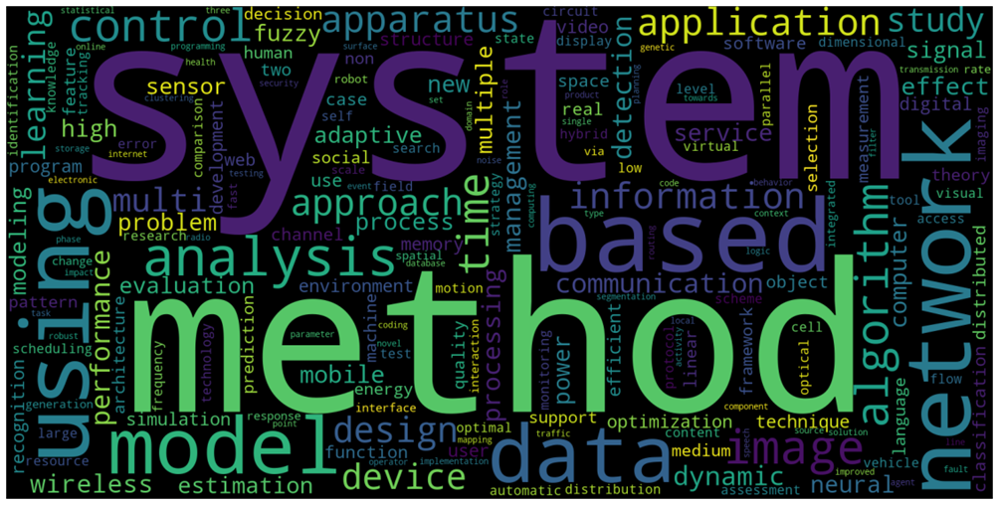
Preprocessing - results
WordCloud of pre-processed documents title:

Slide 17
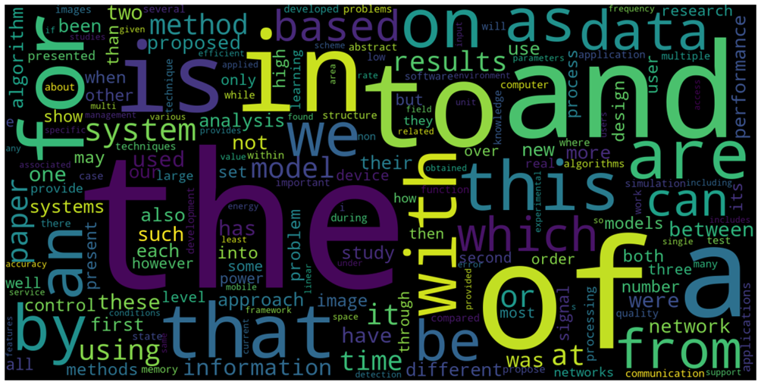
Preprocessing - results
WordCloud of unprocessed documents text:

Slide 18
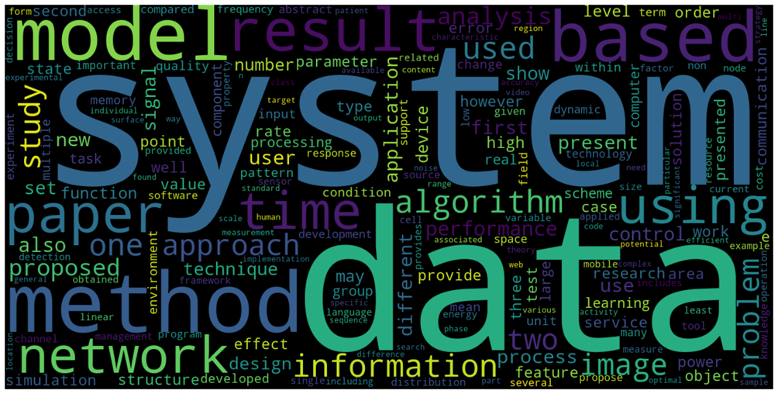
Preprocessing - results
WordCloud of pre-processed documents text:

Slide 19
Experiments
Three very similar experiments will be conducted with the only difference being the version of the document dataset that will be used:
A complete version of the documents collection without preprocessing steps
A resized version of the documents collection that has been pre-processed

Slide 20
Experiments - indexes
Three different indexes were created to conduct such experiments:
An index created using the pre-processed version of the resized documents collection titles
An index created using the pre-processed version of the resized documents collection texts
An index created using the unprocessed version of the complete documents collection texts

Slide 21
Experiments – models used
Two different search models have been created for each of the previously shown indexes:
Term frequency–inverse document frequency (TF-IDF) model
Okapi BM25 model

Slide 22
Experiments – metrics
Three different metrics has been used to evaluate the performance of each model:
Average Precision
Precision @ 10
Precision @ 20

Slide 23
Results evaluation – resized collection results
Results obtained from the experiments that used the models generated with both the title and text of the resized version of the original data frame were unsatisfactory.
Using the documents title index:
- TF-IDF: AP:0.0, P@10: 0.0, P@20: 0.0
- BM25: AP:0.0, P@10: 0.0, P@20: 0.0
Using the documents text index:
- TF-IDF: AP:0.0, P@10: 0.0, P@20: 0.0
- BM25: AP:0.0, P@10: 0.0, P@20: 0.0

Slide 24
Results evaluation – mistakes were made…
It’s clear that something has gone wrong during the setup of parameters that were given to the experiment, probably something related to the creation of the TF-IDF and BM25 models.
Sadly after several attempts I couldn’t figure out where the error was located.

Slide 25
Results evaluation – complete collection results
Both the experiments done using the documents full collection didn’t produce any outcome at all, due to the size of the collection itself and to the lack of resources available causing a RAM overload after several hours of processing.

Slide 26
Thanks for the attention

